Slide 1
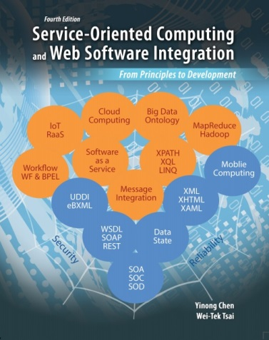


CSE 445 / 598
Distributed Software Development
Chapter 5
Web-Based Application
Development and State/Data Management
Lecture 18: Web Computing Model and Architecture
Yinong Chen

Slide 2
Chapter 5 Outline: Application Building
Web Applications and Web Computing Models
Web Application Architecture
Web Application Controls and Components
Server Controls (HTML and Web Controls)
User Controls
Web Configuration
Global Control
DLL
Web Application State Management
Cookies, Session State, Application State
Server side file system
Web Caching
L18
L19
L20
L21
L22

Slide 3
Domains of Web Computing and Applications
Web computing-based applications have penetrated into all areas and are reshaping the world
Business
Computing and Communication
Education
Financial Services
Healthcare and Health Plans
Manufacturing
Retail
Social and Media
…

Slide 4
Web Computing Models
Pure HTML Web with Server Process Support
HTML with Embedded Client-Side Scripting
Dynamic HTML (DHTML) concept
E.g., JavaScript, VBScript
Server-Side Scripting and Code Behind Presentation
Any programming language supported by the server
Page Postback vs. Partial Page Update
AJAX
Client-Side Out-Of-Browser Computing
Adobe Flash
Silverlight

Slide 5
Web Computing Models 1 and 2
Client browser
Server
<html>
…
…
</html>
Pure HTML
forms
<html>
…
…
</html>
<html>
…
…
</html>
Processing
<html>
…
…
</html>
HTML
with embedded scripting
<html>
…
…
</html>
Run at client
Scripting
Scripting

Slide 6
Web Computing Models 3 and 4
<% Page Language
<!DOCTYPE html
<html>
…
</html>
ASPX forms Postback
<html>
…
…
</html>
<html>
…
…
</html>
ASPX.cs
Run at Server
<% Page Language
<!DOCTYPE html
<html>
…
</html>
ASPX forms
With AJAX
<html>
…
…
</html>
ASPX.cs
Run at Server

Slide 7
Web Computing Model 5
<html>
…
…
</html>
Silverlight
<html>
…
…
</html>
Run at client
Scripting
.zap file with code
Scripting
Silverlight with ASPX
and AJAX
<% Page Language
<!DOCTYPE html
<html>
…
</html>
<html>
…
…
</html>
ASPX.cs
.zap file with code
Run at Server

Slide 8
Chapter 5 Outline: Application Building
Web Computing Models
Web Application: Architecture Point View
Web Application Controls and Components
Server Controls (HTML and Web Controls)
User Controls
Web Configuration
DLL
Web Application State Management
Global Control
Cookies, Session State, Application State
Server side file system
Dynamic Graphics, Animation, Mobile Computing
L18

Slide 9
Client-Server Architecture: Thin and Thick Client
Thin Client Architecture
Pure HTML Web with Server Process Support
Client-Side Scripting with Lightweight Programming
Server-Side Scripting and Code Behind Presentation
Thick Client Architecture
Client-Side Scripting with Heavyweight Programming
Possible, but not a good model, because it can get messy and unreliable without modular design
Client-Side Out-Of-Browser Computing
Good use of thick client
Examples: Adobe Flash and Silverlight

Slide 10
Web Application vs. Desktop Application
A traditional desktop application
has a unique entry point – main method;
can be compiled into a stand alone executable file;
can consist of many files, but a project file organizes them into a well defined application domain.
A Web application
consists of a collection of Web pages (groups of classes);
can be entered from any of the pages, even if the designer has a default “entry” page in mind;
follows event-driven computing model
has a coherent mission and shares common resources.

Slide 11
Web Applications & Distributed Computing
A Web application within its application domain is distributed
It consists of multiple “pages”, each of which is an autonomous “object”;
The pages share common resources in the application domain;
The pages can communicate with each other in a loosely couple manner: shared memory, asynchronous callback;
Multiple instances (threads) can be created from one application or service to support multiple users in parallel.
A Web application exists beyond its application domain
Use remote web services as its functional units
Communicate with other Web applications

Slide 12
Web Applications & Future Computing
Web applications are rapidly expanding
For every desktop application, an web version has been or is being developed;
Web 2.0 (Web is the computing platform);
Web integration, such as Web mashup of data and computing resources
Web 3.0 Semantic Web and Ontology
Big Data Management and Analysis
Cloud computing: Moving from desktop computing to Web-based computing and enabling programs and data access anywhere and anytime through:
SaaS (Software as a Service): service-oriented computing
PaaS (Platform as a Service): IDE, e.g., VS, Eclipse
IaaS (Infrastructure as a Service): Hardware as services
DaaS (Device as a Service) and Robot as a Service (RaaS)
Part II of Text and CSE446

Slide 13

Application Domains in a Web Server
Web applications are hosted in Web server. Applications are independent of each others.
Web Server
Covert to Application: Register to the server
Application Domain
Application Domain
Application Domain
Isolation among different domains
. . .

Slide 14
Structure of ASP.Net Web Application
An ASP.Net application consists all the files in the application directory and its sub-directories.
An ASP.Net application includes following types of files:
ASPX files and html and Web controls
ASCX files and user controls
Web.config files containing configuration settings
A single Global.asax file containing global application elements
DLL (dynamic link library) files containing custom types employed by the application
ASMX or SVC files: services used, typically but not in the application directory
The simplest application contains one ASPX file
Default.aspx
Web.config
MyWebApp

Slide 15
Directories Created by Application
Bin: Contains executable code (pre-compiled) and DLL files
App_Code: Contains source code of programs (not compiled)
App_Data: Store text files, XML files, and database files
App_WebReferences: Store references to Web services that are added to the application
…

Slide 16
A More Complex ASP.Net Web Application
One per directory and can be overridden
Unique
MyWebApp root
Global
.asax
Web
.config
Forms
User control files
.aspx
files
.ascx
files
.aspx
files
.aspx
files
.aspx
files
.aspx
files
Override the parent .config file
User defined dir
App_Data
bin
XML file
.dll
file
.exe
file
.aspx
files
.aspx
files
Web
.config
DB file
XML file
.aspx
files
.aspx
files
.aspx
files
.aspx
files
.aspx
files
.aspx
files
.aspx
files
XML file

Slide 17
Chapter 5 Outline: Application Building
Web Computing Models
Web Application Architecture
Web Application Controls and Components
Server Controls (HTML and Web Controls)
User Controls, and Web Configuration
Global Control
DLL
Web Application State Management
Cookies
Session State, Application State
Server side file system
Dynamic Graphics, Animation, Mobile Computing
L18

Slide 18
ASP.Net Web Application and Its Components
ASPX files and server controls (html controls and Web controls)
ASCX files containing user controls
Web.Config files containing configuration settings
A Global.asax file containing global application elements
DLL (dynamic link library) files containing custom types employed by the application

Slide 19
ASPX Web Page and Server Controls
An ASPX page’s Graphic User Interface (GUI) can be built using a set of Server Controls;
A server control
is an “object”, which forms a component in the ASPX page;
can take input and emit an event upon an input, and thus, we can write an event handler to process the input;
can generate an output and render the output into html format, so that the output can be displayed in a web page.

Slide 20
Server Controls Available
There are two kinds of Server controls for GUI design:
HTML controls: They are objects that generate the similar-looking html components on server side, so that all html functions can be handled in one-to-one mapping.
Handlers can be linked behind the controls, and thus, the data can be processed immediately;
In pure HTML case, the data has to be sent to the server and the handler has to be located;
Web controls: They provide additional components that do not exist in html pages. These components are often more powerful.

Slide 21
ASPX Web Form Design and Controls
html controls Each html tag has counterpart in html control. For example:
<input type=“text” RunAt=“server” />
<form RunAt “Server”>
Web controls: add more complex components to the GUI design. Each Web control be define a library class
Web controls come from classes defined in the namespace System.Web.UI.WebControls. They are declared by prefixing the class name with asp and/or postfixing RunAt = “server”. For example:
<asp:TextBox ID = “op1” RunAt=“server” />

Slide 22
HTML Controls on Server Side
To facility direct translation of existing html file into web form, for each action tag, .NET FCL provides a corresponding html Control:
<button runat= “server”> HtmlButton
<input type=“button” runat=“server”> HtmlInputButton
<input type=“reset” runat=“server”> HtmlInputButton
<input type=“submit” runat=“server”> HtmlInputButton
<input type=“checkbox” runat=“server”> HtmllnputcbeckBox
<input type=“file” runat=”server”> HtmlInputFile
<input type=“hidden” runat=“server”> HtmlInputHidden
<input type= “image” runat=“server”> HtmlInputlmage
<input type=“radio” runat=“server”> HtmlInputRadioButton
<input type=“password” runat=“server”> HtmlInputText
<input type=“text” runat=“server”> HtmlInputText
<a runat= “server”> HtmlAnchor
<form runat= “server”> HtmlForm
<select runat=“server”> HtmlSelect
<table runat= “server”> HtmlTable
<td runat=“server”> HtmlTableCell
<th runat=“server”> HtmlTableCell
<tr runat=“server”> HtmlTableRow
<textarea runat=“server”> HtmlTextArea
<img runat=“server”> HtmlImage
Any other tag with runat=“server” HtmlGenericControl
HTML
Input
Control
Tag
HTML
Container
Control

Slide 23
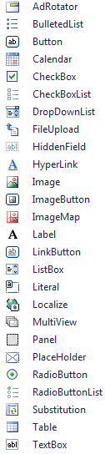
Web Controls on Server Side
.NET Framework Class Library (FCL) provides the following six categories of Web Controls
“Simple” controls, so called because (in general) they wrap simple HTML control tags
Button controls, which create various types of buttons in Web forms
List controls, which display simple lists of items
Data-bound controls, which use data binding to display information obtained from databases and other data sources
Calendar controls, whose sole member, Calendar, adds interactive calendars to Web forms
Validation controls, which validate user input before and after forms are submitted to the server

Slide 24
Implementing Web Computing Models Using Web Controls and Components
Examples of Web Computing Models and Web Applications

Slide 25
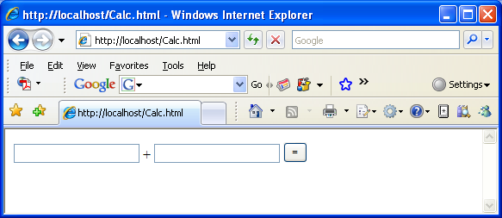
(1) Pure HTML Form for an “Adder” Page
<html>
<body>
<form>
<input type="text" name="op1" />
+
<input type="text" name="op2" />
<input type="submit" value=" = " />
</form>
</body>
</html>
The form sends two numbers to the sever. A sever process needs to extract the number, process, and send result back

Slide 26
Example of Web Computing Model with Pure HTML
Client browser
Server
<html>
…
…
</html>
Pure HTML
forms
<html>
…
…
</html>
<html>
…
…
</html>
Processing
Run at sever side
How do you implement it?
Waiting for data file;
Start a process;
Read the data;
Process the data;
Generate html data
Post back to browser
Delete the process

Slide 27
How does the sever process handle the input numbers?
CGI (Common Gateway Interface) for pure html
Under UNIX
Using Perl, PHP (other languages are possible)
It could be slow because, most implementations launch a new process to handle each request, even if just doing a+b
ISAPI (Internet Server API) extension of DLL for pure html
Under Windows OS
Low level programming required. For a simple Calculator application, it is about 80 lines of code to extract numbers, process them, and post back.
Scripting: Javascript, Active Server Pages (.asp)
ASP .Net (.aspx)
Using html control
Using Web control

Slide 28
Example: Perl CGI Code for Generating HTML Form Source: http://perlmeme.org/tutorials/cgi_form.html
h2 {
color: darkblue;
border-bottom: 1pt solid;
width: 100%;
}
div {
text-align: right;
color: steelblue;
border-top: darkblue 1pt solid;
margin-top: 4pt;
}
th {
text-align: right;
padding: 2pt;
vertical-align: top;
}
td {padding: 2pt; vertical-align: top;} /* End Stylesheet code */
',
},
);
print $q->h2("A Questionaire");
}
# Outputs a footer line and end html tags
sub output_end {
my ($q) = @_;
print $q->div("My Web Form");
print $q->end_html;
}
print $q->Tr(
$q->td('Age:'),
$q->td(
$q->radio_group(
-name => 'age',
-values => [
'0-12', '13-18', '18-30', '30-40', '40-50', '50-60', '60-70', '70+'
],
-rows => 4,
)))
my %genders = ('F' => 'Female', 'M' => 'Male');
print $q->Tr(
$q->td('Gender:'),
$q->td(
$q->popup_menu( -name => 'gender', -values => [keys %genders], -labels => \%genders,)));
print $q->Tr(
$q->td('Favourite Languages:'),
$q->td(
$q->checkbox_group(
-name => 'language',
-values => ['Perl', 'C', 'C++', 'C#', 'Java', 'VB', 'Python', 'Delphi'],
-defaults => ['Perl'],
-columns => 2,
)))
print $q->Tr($q->td($q->submit(-value => 'Submit')), $q->td('&nbsp;'));
print $q->end_table;
print $q->end_form;
}
# Displays the results of the form
sub display_results {
my ($q) = @_;
my $username = $q->param('user_name');
my $userage = $q->param('age');
my $usergender = $q->param('gender');
my @favourite_languages = sort $q->param('language');
my %sex = ('F' => 'girl', 'M' => 'boy');
print $q->h4("Hi $username");
print $q->p("You are a $sex{$usergender}, and you are $userage years old.");
print $q->p("Your favourite languages are:");
print $q->table(
{-border => 1, -cellpadding => 3},
$q->Tr($q->td(\@favourite_languages)),
);
}
# Outputs a web form
sub output_form {
my ($q) = @_;
print $q->start_form(
-name => 'main',
-method => 'POST',
print $q->start_table;
print $q->Tr(
$q->td('Name:'),
$q->td(
$q->textfield(-name => "user_name", -size => 50)
) )
#!/usr/bin/perl
use strict; use warnings; use CGI;
my $q = new CGI;
print $q->header();
# Output stylesheet, heading etc
output_top($q);
if ($q->param()) {
# Parameters are defined, therefore the form has been submitted
display_results($q);
} else {
# We're here for the first time, display the form
output_form($q);
}
# Output footer and end html
output_end($q);
exit 0;
# Outputs the start html tag, stylesheet and heading
sub output_top {
my ($q) = @_;
print $q->start_html(
-title => 'A Questionaire',
-bgcolor => 'white',
-style => {
-code => '
/* Stylesheet code */
body {
font-family: verdana, sans-serif;
}
Start a new CGI process
Read input from html form
Generate html output
Generate html style

Slide 29
(2) Implementing Web Computing Model with Client-Side Scripting
<html>
…
…
</html>
HTML
with embedded scripting
<html>
…
…
</html>
Run at client
Scripting
Scripting

Slide 30
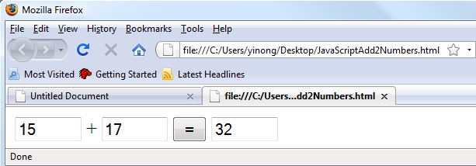
Example of Client-Side Scripting
Script is inserted in html
<html> <body>
<script type="text/JavaScript">
function add2Nos() {
document.sum.z.value = parseInt(document.sum.x.value) + parseInt(document.sum.y.value)
}
</script>
<form name="sum">
<input type="text" name="x" size=5 maxlength="5">
+
<input type="text" name="y" size=“5" maxlength="5">
<input type="button" value =" = " name="Submit" onClick="add2Nos()">
<input type="text" name="z" size="5" maxlength="5">
</form>
</body>
</html>

Slide 31
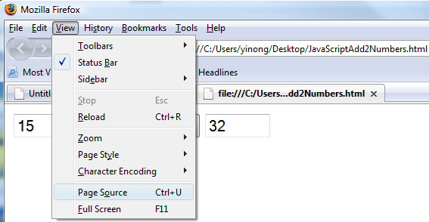
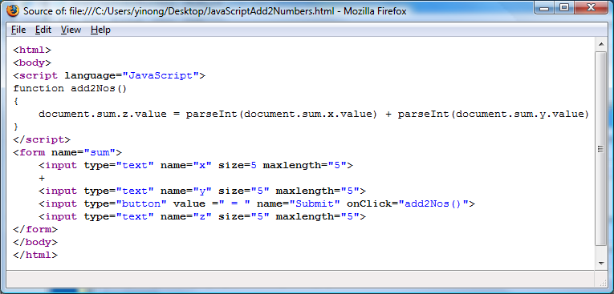
What can be seen by View Source?

Slide 32
Good and Bad of Client-Side Scripting
Computing is done in the client browser. Reduce the overhead of sending data back and forth;
Script programs are interpreted. Interpretation is slower than executing compiled code, if code is heavy;
Script code is not reusable: Cannot be called from other pages.
Code can get messy if one try to implement thick client
Security and proprietary issues:
Code is visible via “View Source”;
Allowing the code running on the client machine presents a security hazard to the client machine;

Slide 33
Security and Proprietary with Client-Side Scripting
Security Issues:
Code is visible via “View Source”, allowing the attackers to explore the data processing process
Cross-Site Scripting (XSS): Script programs are transferred from attacker’s page to the visitor’s browser and are executed on client side
Proprietary issues:
Code is visible via “View Source”, allowing competitors to explore the business logic behind the programs
What is about the other client-side computing model: Silverlight or flash-based out-of-browser computing model?
Free Antivirus Software
Install
Quit

Slide 34

(3) Example of Out-Of-Browser Model
<html>
…
…
</html>
Silverlight
<html>
…
…
</html>
Run at client
Sandbox
Scripting
.zap file with code
Scripting
Computing is done on client side. Reduce the overhead of sending data back and forth;
Code is structured like server-side programming;
Security and proprietary issues for any client-side computing model:
Allowing the code running on the client machine presents a security hazard to the client machine. Silverlight Sandbox Solution: Not allowed to access any native applications, unless through public APIs or services.
Code is visible via “reverse engineering”.

Slide 35
“Reverse Engineering” of Silverlight Code
A deployed Silverlight application consists of two files:
An html file and a .zap file. The latter is a zip file
Use “view source” to view HTML source;
An element in the HTML code pointing to the zap file:
<param name=“source” value=“myCalculator.zap” />
In the address bar of the browser, replace myCalculator.zap for HTML file name, e.g., index.html
Download/Save the file, & rename the file to a .zip file;
Unzip the file, you obtain the MSIL assembly code;
Use a tool, e.g., Reflector, you can view the MSIL code;
There are tools that decompile the MSIL code to C#.

Slide 36
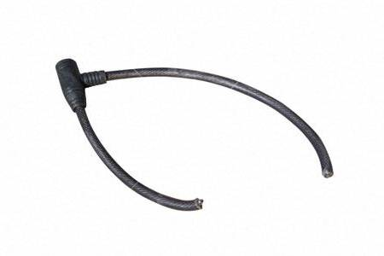

Ethics and Laws on “Reverse Engineering”
Reverse engineering is acceptable, only if
You own the source code
You have explicit permission to view the code
Otherwise, reverse engineering is
unethical for reading the code
a crime for using the code
Laws related to reverse engineering, e.g.,:
http://ethics.csc.ncsu.edu/intellectual/reverse/
As a software engineer, prevent “reverse engineering”:
Server-side code for security and proprietary code
Use an obfuscation tool to make it harder. VS comes with a tool named Dotfuscation. Other tools exist.

Slide 37
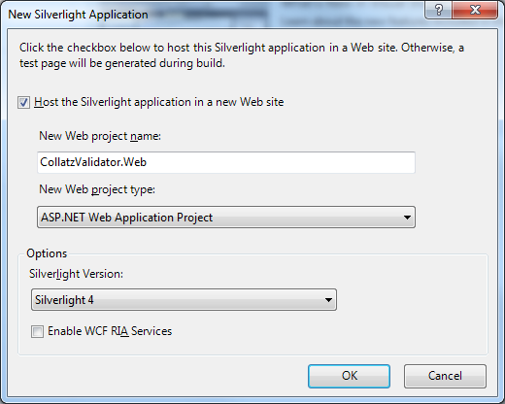
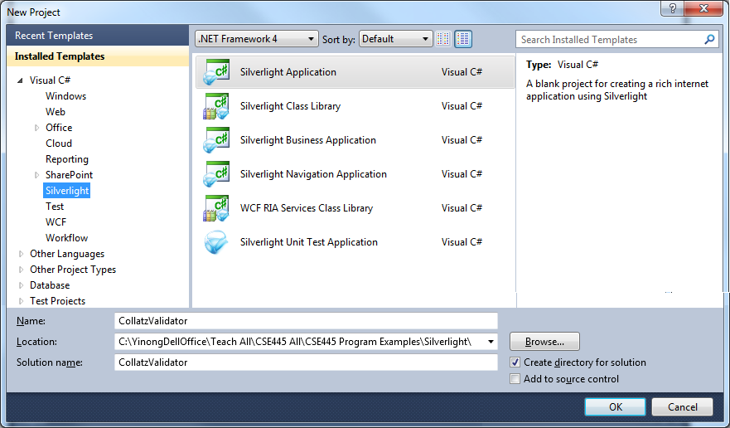
Creating a Silverlight Web Application
File → New Project

